Slide 1
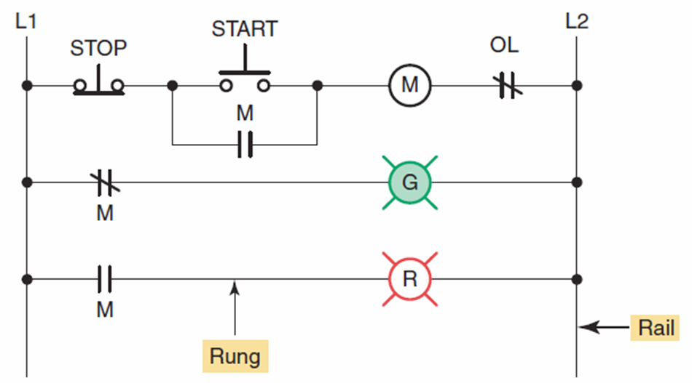
Hardwired motor control program.

Slide 2
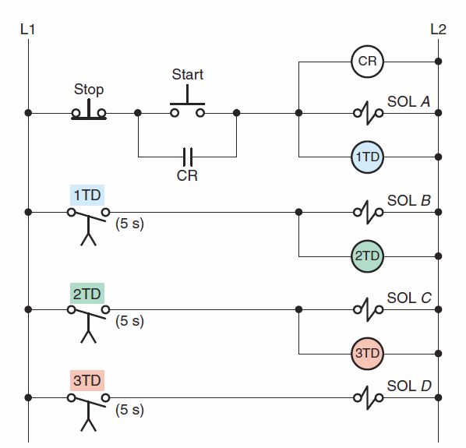
Hardwired relay-operated, time-delay circuit.

Slide 3
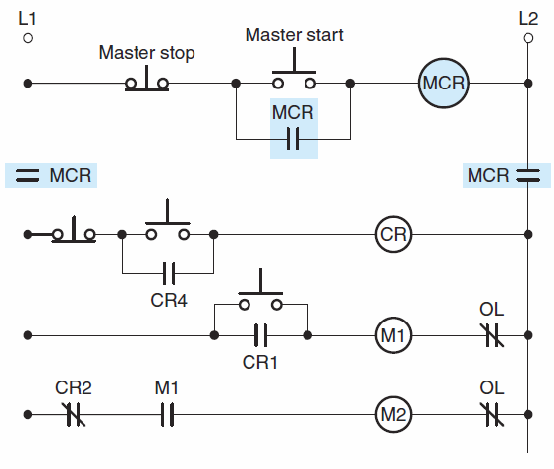
Hardwired master control relay circuit.

Slide 4
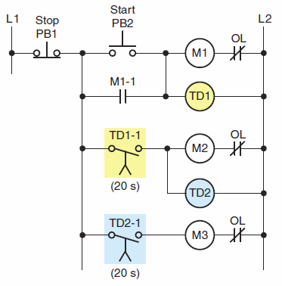
Hardwired sequential
time-delayed
motor starting circuit.

Slide 5
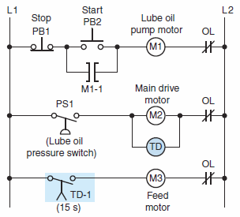
Hardwired relay circuit

